Slide 1
Cosc 2150:
Computer Organization
Chapter 13:
Selected Storage Systems and Interfaces

Slide 2
Introduction
This chapter is a brief introduction to several important mass storage systems.
  You will encounter these ideas and architectures throughout your career.
The demands and expectations placed on storage have been growing exponentially.
  Storage management presents an array of interesting problems, which are a subjects of ongoing research.

Slide 3
Introduction
Storage systems have become independent systems requiring good management tools and techniques.
The challenges facing storage management include:
  Identifying and extracting meaningful information from multi-terabyte systems.
  Organizing disk and file structures for optimum performance.
  Protecting large storage pools from disk crashes

Slide 4
I/O interfaces IDE
Names | Max Speed (MB/s) | # of devices | External connector type
IDE, EIDE, ATAPI | 3.3 | 2 (1 master, 1 slave) | No external connections supported
IDE: Ultra DMA/33 100 | 33 100 | 2 (1 master, 1 slave) | No external connections supported

Slide 5
SCSI
SCSI, an acronym for Small Computer System Interface, is a set of protocols and disk I/O signaling specifications that became an ANSI standard in 1986.
The key idea behind SCSI is that it pushes intelligence from the host to the interface circuits thus making the system nearly self managing
The SCSI specification is now in its third generation, SCSI-3, which includes both serial and parallel interfaces.

Slide 6
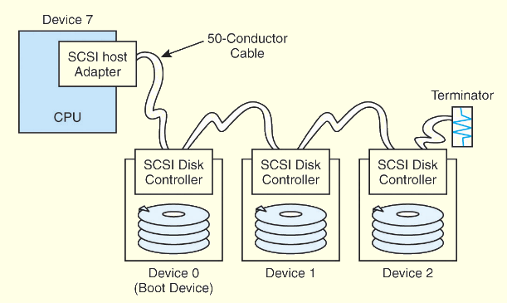
SCSI
Classic SCSI-2 daisy chains the host and disk devices along a parallel cable.
Depending on the implement-ation, the cable may contain as many as 68 pins.

Slide 7
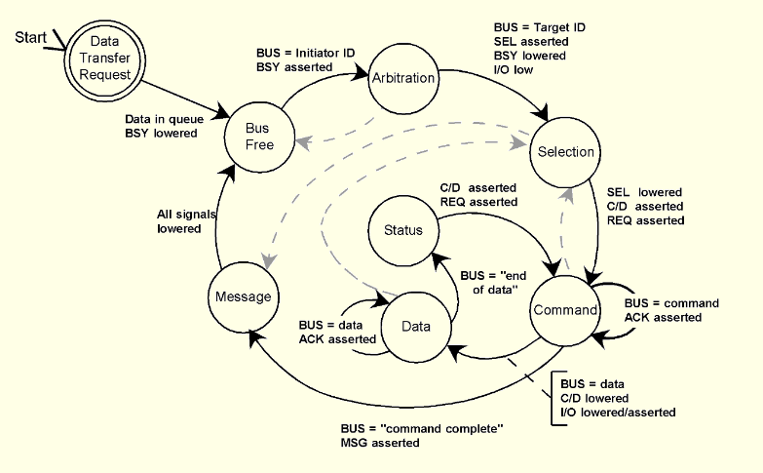
SCSI
The SCSI-2 protocol uses phases, as shown in this state diagram.

Slide 8
SCSI
The SCSI-3 Architecture Model (SAM) is a layered architecture of specifications for numerous serial and parallel interfaces.
Each layer interacts with a host-level command architecture called the SCSI-3 Common Access Method (CAM) that can interface with practically any type of storage device.
The layers communicate with each other using protocol service requests, indications, responses, and confirmations.
We show the SAM on the next slide.

Slide 9
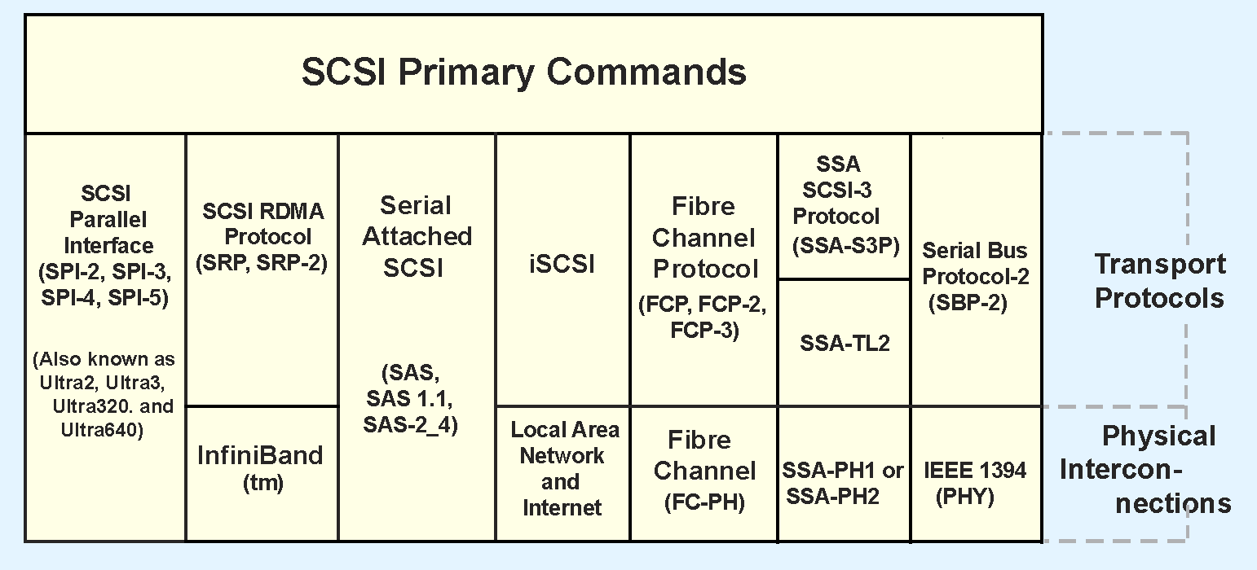
SCSI
The SCSI-3 Architecture Model

Slide 10



I/O interfaces SCSI
Names | Max Speed (MB/s) | # of devices | External connector type
SCSI –1 | 5 | 8 (including scsi card) | 50-Pin low-density Apple DB-25
SCSI-2 (Fast SCSI, Fast Narrow | 10 | 8 | 50-pin low-density 50-pin high-density (SCSI-2)

Slide 11

I/O interfaces SCSI (cont.)
Names | Max Speed (MB/s) | # of devices | External connector type
SCSI-2 Fast Wide SCSI (Wide SCSI) | 20 | 16 | 68-pin
SCSI-3 Ultra SCSI (SCSI-3, Fast-20, Ultra Narrow) | 20 | 8 | 50-pin low density 50-pin high density 68-pin

Slide 12
I/O interfaces SCSI (cont.)
Names | Max Speed (MB/s) | # of devices | External connector type
SCSI-3 Wide Ultra SCSI (Fast Wide 20) | 40 | 16 | 50-pin low density 50-pin high density 68-pin
SCSI-3 Ultra2 SCSI | 40 | 8 | 50-pin low density 50-pin high density 68-pin

Slide 13
I/O interfaces SCSI (cont.)
Names | Max Speed (MB/s) | # of devices | External connector type
SCSI-3 Wide Ultra 2 SCSI | 80 | 16 | 50-pin low density 50-pin high density 68-pin
SCSI-3 Ultra 3 SCSI | 80 | 8 | 50-pin low density 50-pin high density 68-pin
SCSI-3 Wide Ultra 3 SCSI (Ultra 160) | 160 | 16 | 50-pin low density 50-pin high density 68-pin

Slide 14
FireWire
the IEEE 1394 interface, which is also known as FireWire.
IEEE 1394 isn’t just a storage interface, it is a peer-to-peer storage network.
Its salient features include:
  A 6-conductor cable, 4 for data and control, 2 for power.
  Up to 15 feet of cable between each device.
  Up to 63 daisy chained devices.
  Support of hot plugging.

Slide 15
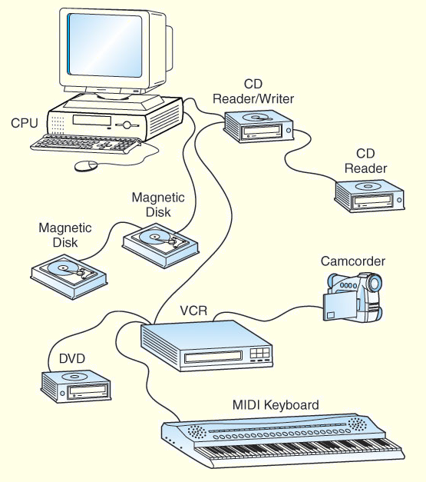
FireWire
An IEEE 1394
Tree Configuration

Slide 16
Future of Fireware
FireWire (IEEE 1394)
  IEEE 1394b: speed of 800Mbps
  Next generation 3.2Gbps
Will USB replace Fireware completely?

Slide 17
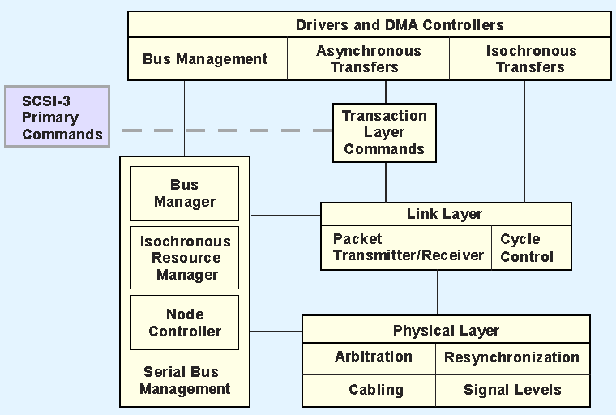
FireWire
This is the IEEE 1394 protocol stack.

Slide 18
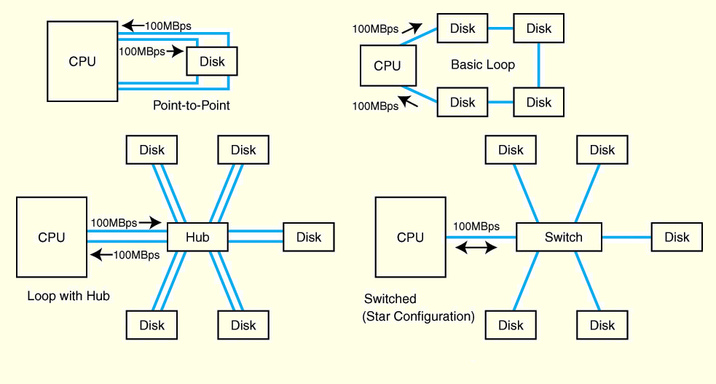
Fibre Channel
Fibre Channel is one the preferred storage interfaces employed by large data centers and server farms.
Interconnection topologies can be any of three types: switched, point-to-point, or looped.

Slide 19
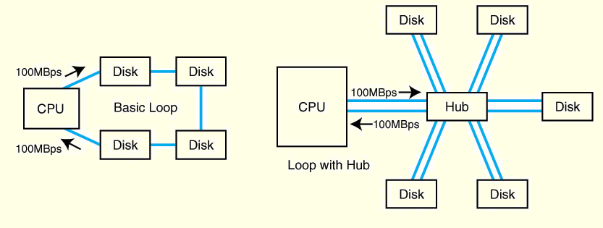
Fibre Channel
The most widely used form of Fibre Channel is Fibre Channel Arbitrated Loop (FC-AL) in basic loop or switched hub configurations.
Switched hub configurations provide maximum throughput (100MBps over fiber) for a practically unlimited number of devices (up to 224).

Slide 20
Fibre Channel
Fibre Channel is as much of a data network protocol as it is a storage network protocol.
The lower three layers of its protocol stack (shown on the next slide) are the same for data networks and storage networks.
Owing to its higher level protocol mappings, Fibre Channel networks do not require direct connection to a host and they can fit seamlessly into a data network configuration.

Slide 21
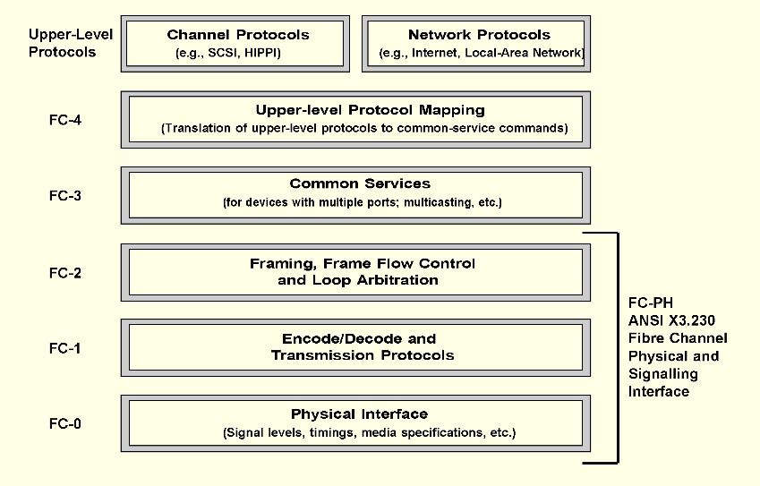
Fibre Channel

Slide 22
Internet SCSI (iSCSI)
Fibre Channel components are costly and installation and maintenance of Fibre Channel systems requires specialized training.
Because of this, a number of alternatives are taking hold. One of the most widely deployed of these is Internet SCSI (iSCSI).
The general idea is to replace the SCSI bus with an Internet connection.

Slide 23
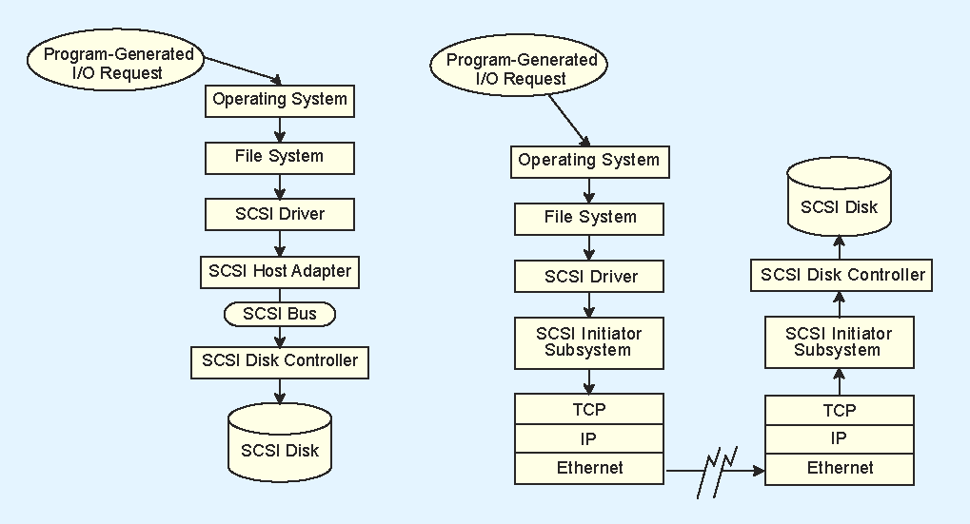
iSCSI
This diagram illustrates how a traditional parallel SCSI system processes an I/O request made by a program running on a host.

Slide 24
iSCSI
This diagram illustrates how an iSCSI system processes an I/O request.

Slide 25
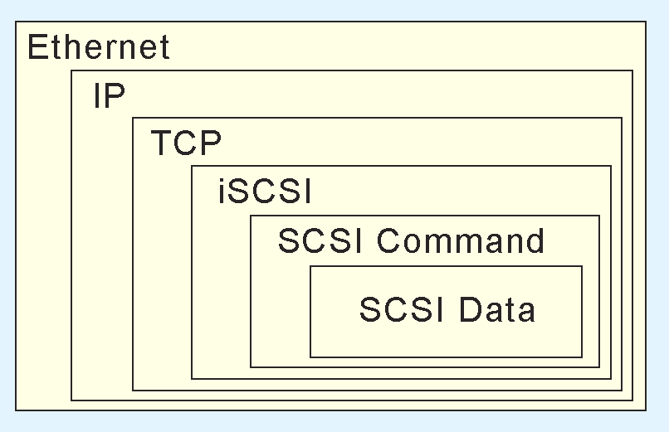
Internet SCSI
Of course, there is considerable overhead involved with traversing so many protocol layers.
By the time a packet of SCSI data gets to the Internet, it is encapsulated in numerous PDUs.

Slide 26
iSCSI
In order to deal with such heavy overhead, iSCSI systems incorporate special embedded processors called TCP offload engines (TOEs) to relieve the main processors of the protocol conversion work.
An advantage of iSCSI is that there are technically no distance limitations.
But the use of the Internet to transfer sensitive data raises a number of security concerns that must be dealt with head on.

Slide 27
iSCSI
Many organizations support both Fibre Channel and iSCSI systems.
The Fibre Channel systems are used for those storage arrays that support heavy transaction processing that requires excellent response time.
The iSCSI arrays are used for user file storage that is tolerant of delays, or for long-distance data archiving.
No one expects either technology to become obsolete anytime soon.

Slide 28
Storage Area Networks
Fibre Channel technology has enabled the development of storage area networks (SANs), which are designed specifically to support large pools of mass storage.
SANs are logical extensions of host storage buses.
Any type of host connected to the network has access to the same storage pool.
  PCs, servers, and mainframes all see the same storage system.
SAN storage pools can be miles distant from their hosts.

Slide 29
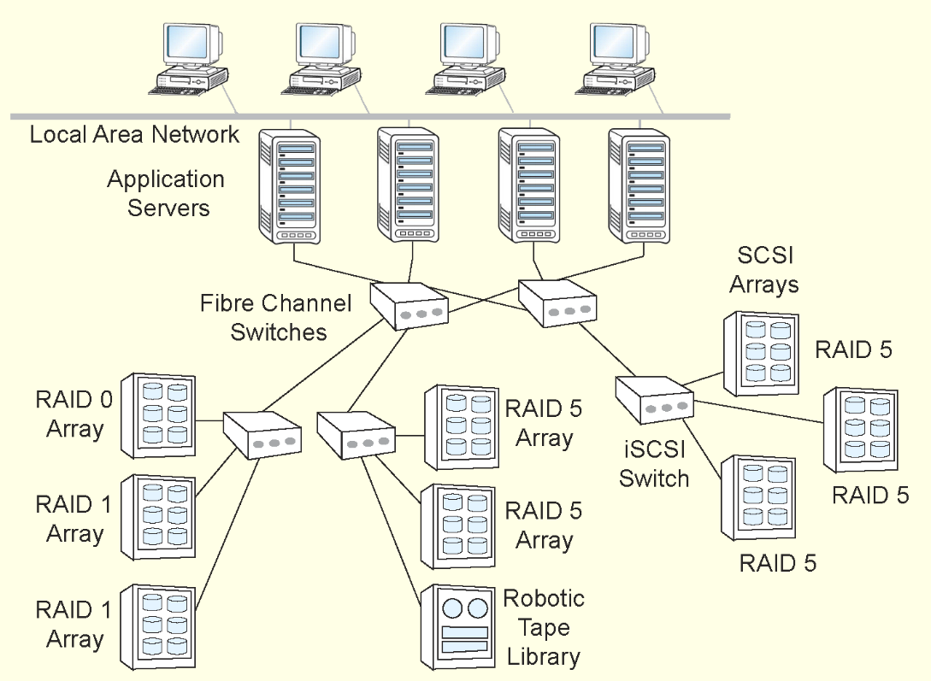
Storage Area Networks

Slide 30
Storage Area Networks
SANs differ from network attached storage (NAS) because they can be isolated from routine network traffic.
This isolation facilitates storage management and enables various security methods.
SANs have a lower protocol overhead than NAS because only the storage protocols are involved.
NAS is gaining popularity because of lower costs for equipment and training of personnel, most of whom are familiar with data networking protocols.

Slide 31
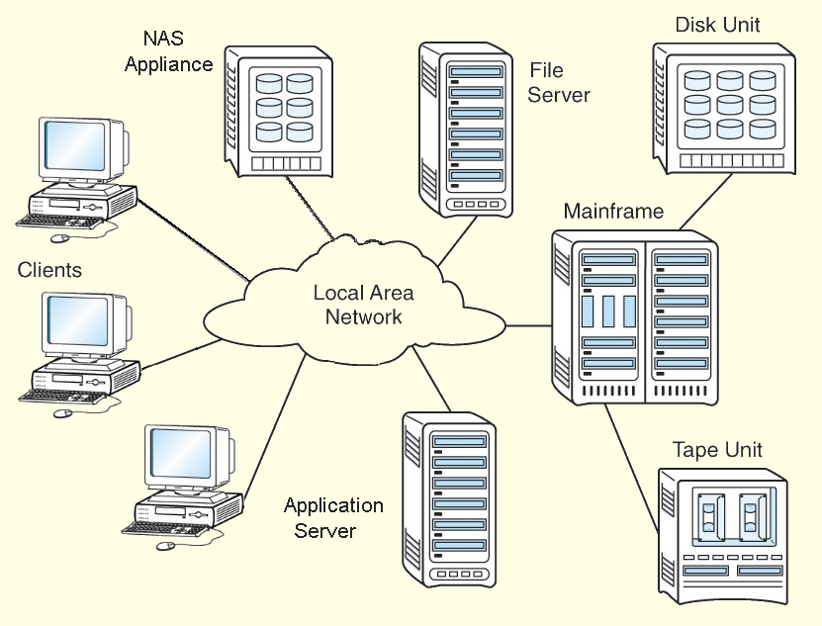
Network Attached Storage

Slide 32
Other I/O Connections
As processor speeds continue to increase, even Ultra ATA (IDE) cannot keep up.
  Furthermore, these fast processors dissipate a lot of heat, which must be moved away from the CPU as quickly as possible. Fat parallel disk ribbon cables impede air flow.
Serial ATA (SATA) is one solution to these problems.
SATA uses thin cables that operate with lower voltages and longer distances.

Slide 33
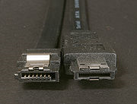
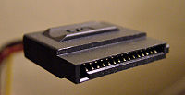
Serial ATA (SATA)
SATA 1 or SATA 150
  1.5 Gb per sec
SATA 3Gb/s (SATA II or SATA2)
  Backward compatible for 150 devices
SATA 6Gb/s (SATA3)
  And 3.1 version (2010)
Connectors:
Left internal Power cable
Right external

Slide 34

SAS
Serial Attached SCSI (SAS)
SATA drives can be connected to SAS
  But SAS can’t be connected to SATA
1.5, 3.0, 6.0 Gb/s (Feb 2009)
A SAS domain may contain up to a total of 16,256 devices. With port expanders: 65k
SAS connector :
  Form factor compatible with SATA: allows for SATA drives to connect to a SAS backplane
    So no need for a SATA controller just to attach a DVD.
  Note, there are several other connectors types.
    10 m external cables

Slide 35



I/O interfaces Parallel & USB
Names | Max Speed (MB/s) | # of devices | External connector type
Parallel Standard Port | .15 | 1 | 25-pin
Parallel EPP, ECP | 3 | 4 | 25-pin
USB 1 | 1.5 – 12 | 27

Slide 36

USB 2.0
Fully backwards compatible with USB 1.1
Speeds of up to 480 Mega bits per second
  Supports 1.5 Mbps, 12Mbps and 480 Mbps speed
  Supports dynamic speed changing
  Supports multiple speeds in one tree.
Supports up to 127 devices.

Slide 37
USB 2.0 device connection
External
CDRW
The speed can be changed if
needed
480Mbps
Keyboard
With USB hub
(USB2.0)
Mouse
1.5Mbps
M.B
1.5Mbps
1.5Mbps
12Mbps
480Mbps
USB 2.0
HUB
PC
camera
480 Mbps
12 Mbps

Slide 38

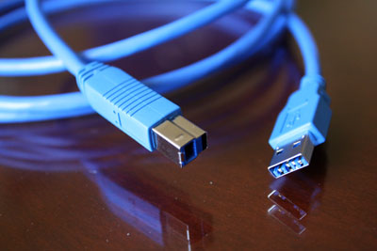
USB 3.0
Standard expected in early 2010
  dubbed USB Superspeed, backward compatible to 2.0
Max speed is 4.8Gbps
  The USB 3.0 A and B-side connectors

Slide 39

USB wireless
Wireless USB is the new wireless extension to USB that combines the speed and security of wired technology with the ease-of-use of wireless technology.
  Wireless USB is the first high-speed wireless personal interconnect technology to meet the needs of multimedia consumer electronics, PC peripherals, and mobile devices.
  Wireless USB will preserve the functionality of wired USB while also unwiring the cable connection and providing enhanced support for streaming media CE devices and peripherals.
  Wireless USB performance is targeted at 480Mbps at 3 meters and 110Mbps at 10 meters.
  Expected by mid/late 2010, early 2011
From http://www.usb.org/developers/wusb/

Slide 40
Other I/O Connections
The High Performance Peripheral Interface (HIPPI) is another interface that is outside of the SCSI-3 Architecture Model.
It is designed to interconnect supercomputers and high-performance mainframes.
Present top speeds are 100MBps with work underway for a 6.4GBps implementation.
Without repeaters, HIPPI can travel about 150 feet (50 meters) over copper and 6 miles (10 km) over fiber.

Slide 41
Chapter 13 Conclusion
We have examined a number of popular I/O architectures to include SCSI-2, FC-AL, ATA, SATA, SAS, PCI, USB, IEEE 1394, and HIPPI.
Many of these architectures are part of the SCSI Architecture Model.
Fiber Channel is most often deployed as Fiber Channel Arbitrated Loop, forming the infrastructure for storage area networks, although iSCSI is gaining fast.

Slide 42
Q
A
&

